Slide 1
DevXref Work Flow

Slide 2
Objectives to cover
What tasks DB group will cover WRT DevXref_Devices population on EMS (Backfill + maintenance? Or just 1?)
What training or knowledge transfer the DB group requires to fulfill those tasks
What type of automation structure we can design to mitigate long work

Slide 3
DevXref overview
Substation is comprised of devices
DevXref_Devices is a way of recording and accounting for each SCADA device at the substation
Example: Substation has a switch. The devxref for this switch would contain any SCADA points associated with that switch such as the StatusPoint of Switch Status
It would not include SCADA that is not related to or associated with that particular switch device such as the transformer bank temperature, shunt voltage, or the switch status of another switch at that substation.

Slide 4
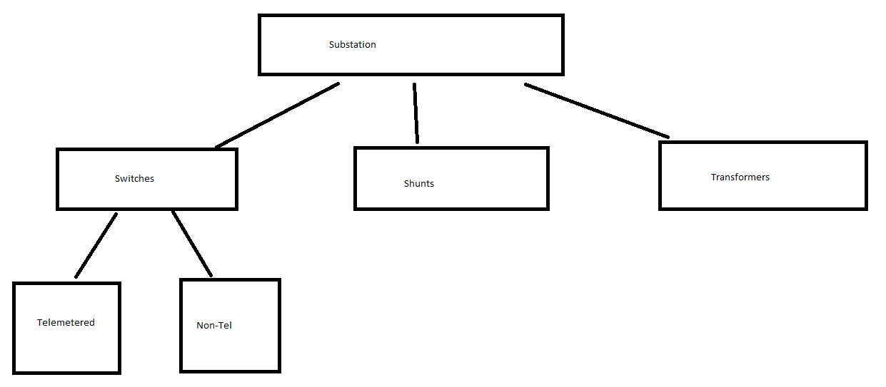
Substation hierarchy (device model)

Slide 5
Currently
Associated SCADA points are stored on the database record for the device.
Example: Psa_Switch is where the Switch Status TP is stored. Psa_Transformer is where the Transformer AnalogPoint is stored.

Slide 6
Devx model
DevXref_Devices records are created to store the SCADA points for each device instead of storing the SCADA point within the device record itself.
Example: Psa_Switch would only define the Switch’s attributes such as switch type, limits, and location.
Any SCADA associated with the switch would be stored on a separate DevXref_Devices record referencing that switch rather than inside the Psa_Switch record as we are doing now.

Slide 7
Pros and Cons
Having a DevXref_Devices record is a universal template which can be modified and changed as our SCADA templates change, or new devices come in.
If more SCADA is added onto a switch, the Psa_Switch table needs to be modified to have a new attribute to store that value.
Instead, with DevXref_Devices, a user can append or modify the ‘Switch’ template, or create a custom template specific to their needs. This gives the customer/user more control.
The downside is that many more tables and relationships exist for a DevXref_Device which not all devices may need. Some devices become more complicated to define due to this trade off.

Slide 8
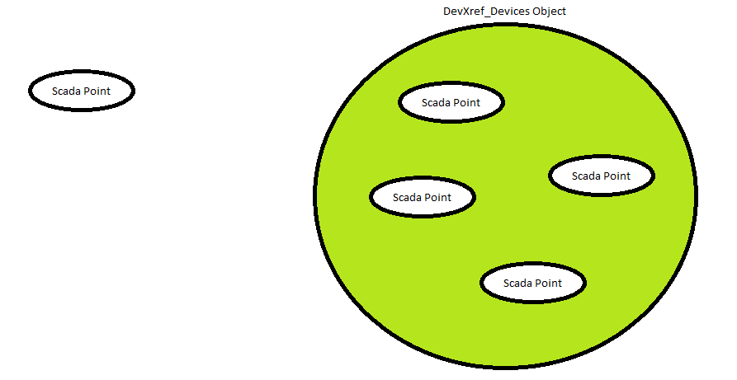
DevXref_Devices store scada

Slide 9
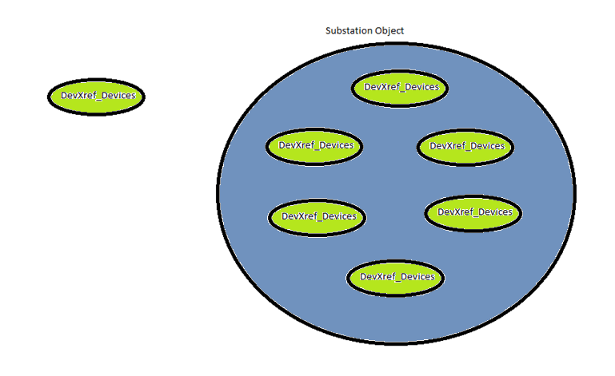
Substations are composed of devxref_devices

Slide 10
Ems device to scada mapping
Device | Associated SCADA
EMS Switch | Switch Status
EMS CB | Switch Status, MW, MVAR, IA, IB, IC, REC, GND RLY, TRGT G, TRGT A, TRGT B, TRGT C, TRGT PH
EMS CAP | MVAR, IA, IB, IC, VOLTAGE
EMS Transformer | MW, MVAR, IA, IB, IC, VOLTAGE AB/BC/CA
EMS SRD (Parallel Transformer) | MW, MVAR, IA, IB, IC, VOLTAGE AB/BC/CA

Slide 11
Back filling
An excel tool can be used to generate DevXref_Devices batch files

Slide 12
EMS SUBSTATION DATA
Excel Automation Tool
GENERATED DEVX
EMS
Data transfer tool
ADMS

Slide 13
Going Forward
Point list is provided by hardware group
While points are added into EMS, DevXref_Devices are concurrently created as well.
Automation tool will probably have to be created to supplement this process

Slide 14
Alternative
Point list is provided
Points created
EMS Adv Apps team create substation model
Excel tool is used to pull the substation and create DevX based on substation.

Slide 15
Point List
EMS
AUTOMATION?
GENERATED DEVX
ADMS

